Slide 1
ML105: Agentic
Rola Dali, PhD
Senior ML/AI Architect December 2025

Slide 2





Evaluating Agents
Layers of the onion
Meta LLM + Engineer
Agentic system
Local LLM
Self-Improving Agentic System

Slide 3









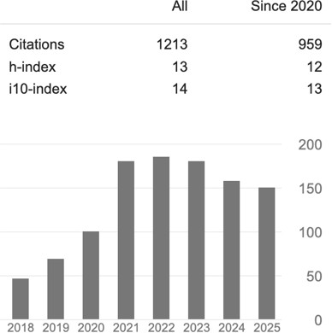




whoami
Machine Learning Architect @
Academic: PhD in NeuroScience & Bioinformatics, 2017 @McGill
Career Interests: Data, AI/ML, Cloud
Tech 42
A qr code with black squares and
2

Slide 4



Agenda
The Rise of Generative AI
The Spectrum of Autonomy
Agentic Timeline
What is an Agent?
Agent Use Cases
Patterns and Anti-Patterns
Designing an Agent
Implementing an Agent
Architectural Patterns
Agent Interface Protocols
Evaluating Agents
Agent Frontier
Agents & Jobs
References
3

Slide 5
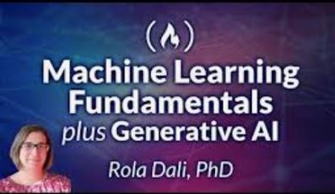

Artificial Intelligence: The rise of Generative AI
Simplified AI Timeline
AI cradle: 1940-1950s
1943: McCulloch & Pitts . “A Logical Calculus of the Ideas Immanent in Nervous Activity”. mathematical model of biological neurons
1950: Alan Turing. "Computing Machinery and Intelligence”. The Turing Test, a benchmark for machine intelligence.
1956: The Dartmouth Workshop established AI as a field of study. John McCarthy coined the term "artificial intelligence".
Machine Learning Renaissance: 1980-1990s
1978: Geoffrey Hinton awarded his PhD in Artificial Intelligence from University of Edinburgh
1997: IBM's Deep Blue defeated Garry Kasparov, in chess
2011: IBM Watson won the TV game show Jeopardy!
Deep Learning Boom: 2010-2020s
2012: AlexNet, a deep learning network, performed well in an image recognition competition
2016: Google DeepMind's AlphaGo defeated world champion Lee Sedol in the game of Go.
Generative AI Boom: 2020s-Present
2017: The transformer paper released by Google researchers providing the blueprint for most modern large language model.
2022: OpenAI's ChatGPT launched in November 2022
What differentiates GenAI from Traditional ML?
5

Slide 6
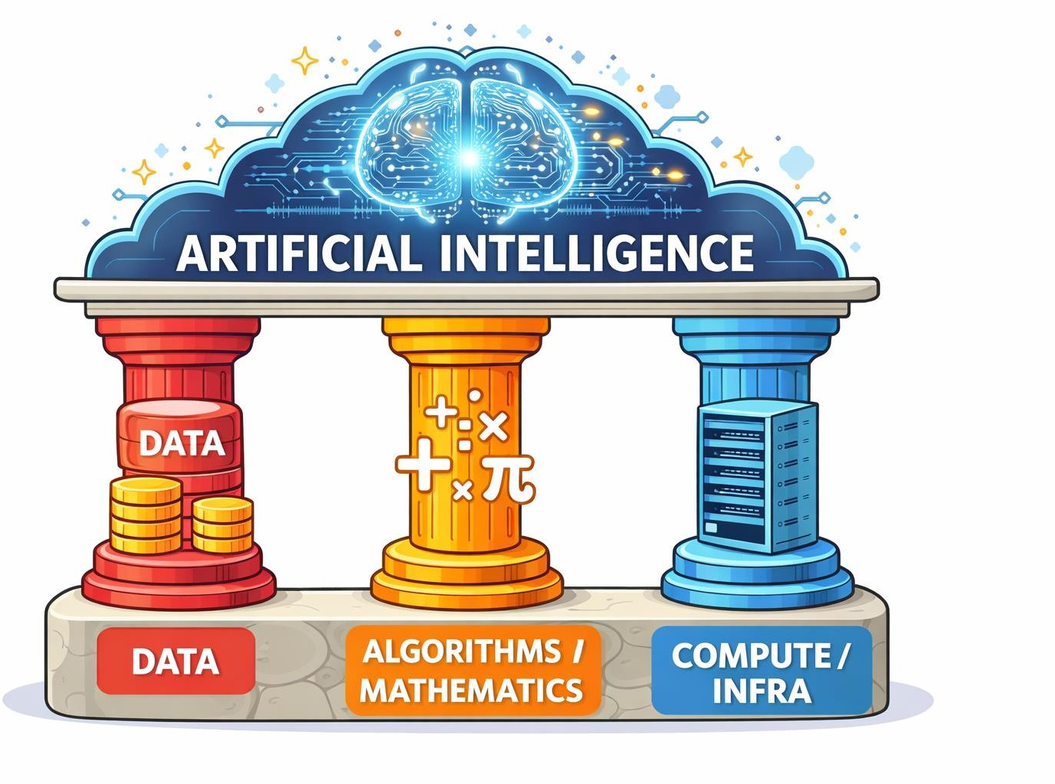
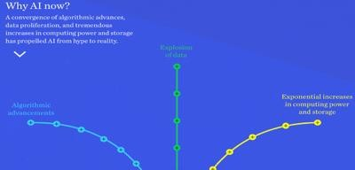

Artificial Intelligence: The rise of Generative AI
GenAI differentiators
McKinsey Why AI now?
| Training Data Size | Model Size (Params) | Compute
Machine Learning | MBs-GBs | Thousands-Millions | Serial
Generative AI | TBs | Billions-Trillions | Distributed/Parallelization
6

Slide 7
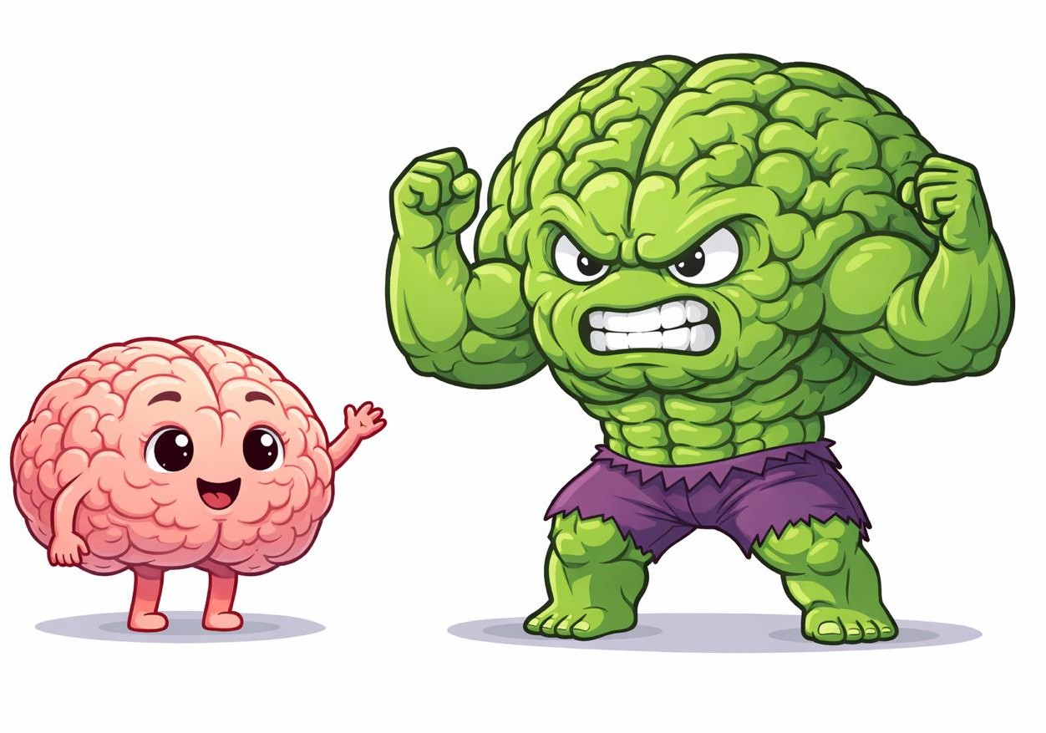
Artificial Intelligence: The rise of Generative AI
GenAI differentiators
What happens when you supercharge data, algorithms and compute?
Models that can use human language
Tasks: specific to general
Rise of Model-as-service
Advancements needed all 3 pillars!
ML
GenAI
7

Slide 8

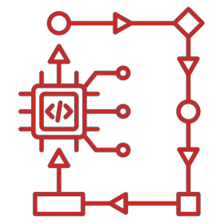







GenAI, Agentic Systems and the spectrum of Autonomy
LLM
single call
LLM
in a loop
Chatbot
Agent
Deep Agent
Autonomous Agentic Systems
AGI
Workflow
Agent Autonomy
Human Control
8

Slide 9



Agentic Milestone Timeline
2017
Transformer
paper
2022
ChatGPT release
2023
Agents
Today
~2 years
The field is still young/maturing
The time stamp matters!
9

Slide 10





What is an Agent?
A GenAI Agent is a software entity designed to perceive its environment, make decisions and take actions to achieve specific goals
Agent pseudocode
while True:
user query = get_user_input() response = invoke_llm(user_query)
while response.has_tool_call():
tool_result = invoke_tool(response.tool_spec) memory = append_context()
response = invoke_llm(tool_output, memory)
Observe
Plan
final_answer = response return final_answer
Act
9

Slide 11


What is an Agent?
A GenAI Agent is a software entity designed to perceive its environment, make decisions and take actions to achieve specific goals
Invoke Model
Invoke Agent
Get response/reasoning/tool
Final Result
Execute tool
Agentic Loop
Tool result
10

Slide 12




What is an Agent?
Agents vs Workflows
Task
Book a travel activity
Check available activities
Check activity availability
Check calendar availability
Book/Pay for activity
Add activity to Calendar
Workflow
Agent
Activities popular in Montreal?
activity_availability()
calendar_availability()
You are an activity booking agent.
Choose activities based on customer preferences Book an available activity & update calendar
activity_availability() calendar_availability() book_activity() update_calendar()
Loop till a desired activity fits availability
book_activity()
update_calendar()
Agent ~ dynamic control flow devised by an LLM at Runtime
Workflows: static, pre-defined coded graphs
11

Slide 13





Agent Use Cases
Pros of using Agents:
Availability: Available 24/7, 365 days/year
Multi-lingual: Delivers multilingual support
Efficiency: Improves response time
Consistency: Ensures more consistent support
Convenience: Offers convenient self-service options
Scale: Serves more customers at scale
Cost: can be cheaper than human
Cons:
Not Human
Technology still maturing
Application space still maturing
Cost: usually more expensive than other software
13

Slide 14


Patterns and Anti Patterns for Agents
When to use, or not to use an agent
Mission Critical/Error Sensitive
Regulated Industries/Deterministic outcomes
Latency Sensitive Cost Sensitive
Performance Flexibility
Model driven Decision Making
14

Slide 15
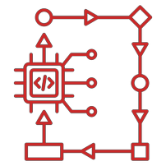

Patterns and Anti Patterns for Agents
When to use, or not to use an agent
Is the application: mission critical/error sensitive or in a highly regulated industry?
Is the task path predictable or can be predefined?
Is the value of the task worth the cost?
Is the latency critical?
Use an agent in cases where error is tolerable, open-endedness is appreciated, the execution path is harder
to code, cost is not an issue and latency can be tolerated
15

Slide 16
Components of an Agent
AI Agents have several Key characteristics
Purpose/Goal
Reasoning/Planning
Memory
Tools & Actions
Tier 2:
Guardrails
Communication
Learning
16

Slide 17




Designing an Agent
Reasoning/Planning
Memory Short-term Long-term
LLM
Purpose/Goal/Mission/Identity
Tools/Actions
Functions
System Prompt
17

Slide 18
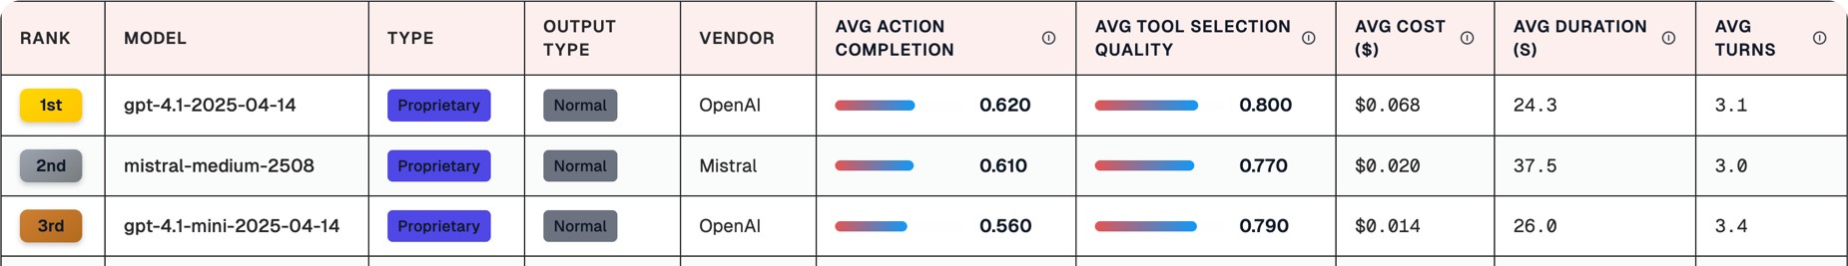
Designing an Agent
Choosing an LLM
Planning
Criteria to consider when choosing a model
Task complexity
Reasoning capabilities
Context window size
Tool Calling
Latency
Cost
Compliance & data privacy
18

Slide 19

Designing an Agent
System prompt
You are medical assistant. You are caring and empathetic
You are a financial advisor. You are eloquent and professional.
You are a teen advisor.
You are young and hip
18
System prompt ~ Agent character/persona & purpose/task & instructions

Slide 20



Designing an Agent
Memory
LLMs are stateless
Intrinsic Memory
Short-Term
Long-Term
Model parameters
Context window
External Storage

Slide 21






Designing an Agent
Actions & Tools
LLMs have limitations that tools can help overcome
Agents can take several actions
Capability extension: calling functions, APIs, …
Knowledge Augmentation: retrieving data or context
Orchestration: calling other agents
Tools can come in the form of
Function Call
API Call
Data retrieval
Browser Action
Code execution
Filesystem control

Slide 22


Implementing an Agent
Other Topics
Model Selection
Prompt Engineering & Context Engineering
Data Management (storage, ranking, retrieval, …)
Memory
Tooling
Interfaces: MCP, A2A, AG-UI
Architecture choices
Deployment approaches
Security & Compliance
Orchestration & Multi-Agent Communication
Error Handling & Remediation
Monitoring and Observability
UI/UX: streaming, latency, …
…. … … …
Single LLM Call
LLM Loop: ChatBot
Simple Agent
Agent with Memory
Agent with LangChain
LangChain Agent with Memory
Agent Architecture

Slide 23


Agentic Architectural Patterns
Workflow
Single Agent
Multi-agent
Hierarchical/Supervisor
Swarm

Slide 24
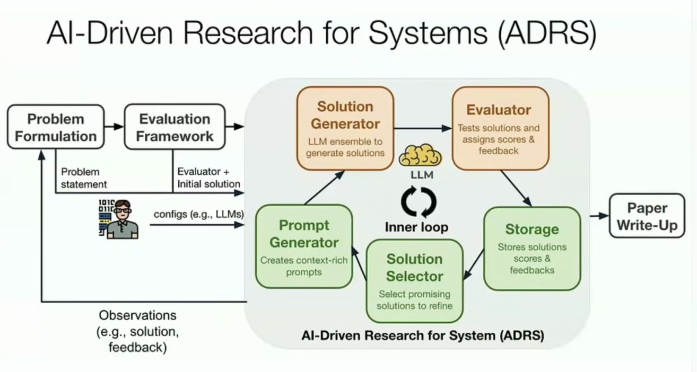
https://adrs-ucb.notion.site/

Slide 25
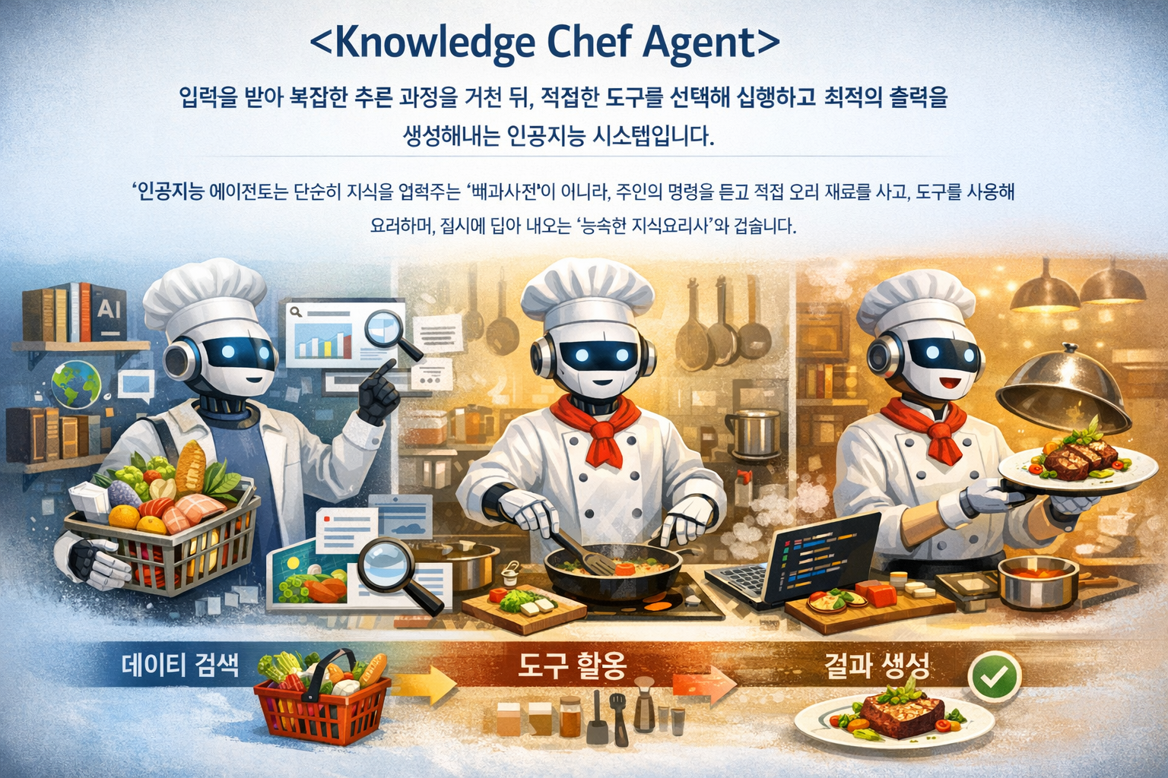
Knowledge Chef Agent
- 에이전트는 입력(Input)을 받아 복잡한 추론 과정을 거친 뒤, 적절한 도구를 선택해 실행하고 최적의 출력(Output)을 생성해내는 통합적인 인공지능 시스템입니다.
"인공지능 에이전트는 단순히 지식을 알려주는 '백과사전'이 아니라, 주인의 명령을 듣고 직접 요리 재료를 사고(데이터 검색), 도구를 사용해 요리하며(도구 활용), 접시에 담아 내오는(결과 생성) '능숙한 지식요리사'와 같습니다."

Slide 26
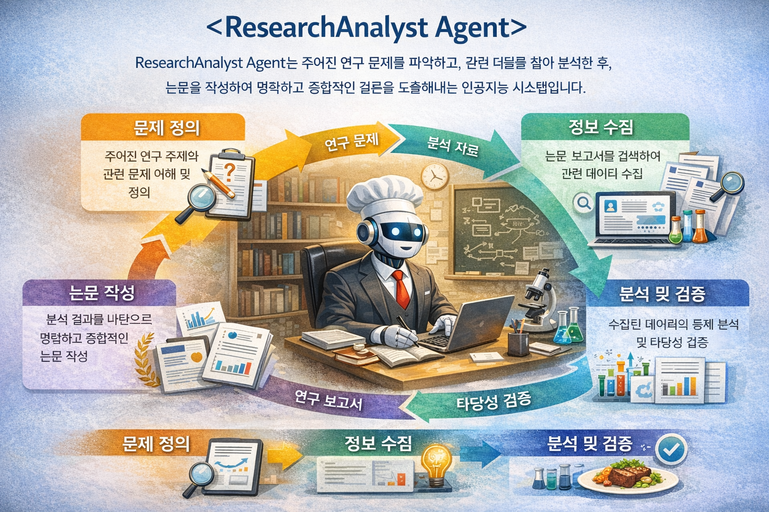

Slide 27
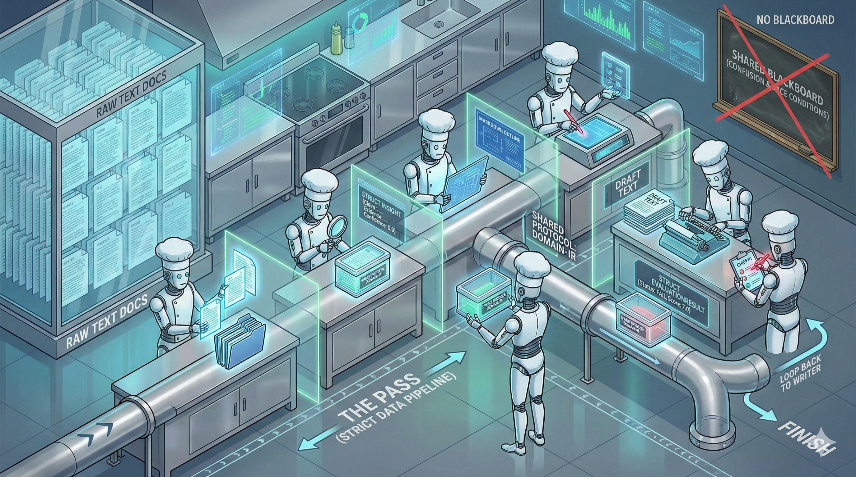
Head Chef (Orchestrator) uses a Strict Data Pipeline.

Slide 28
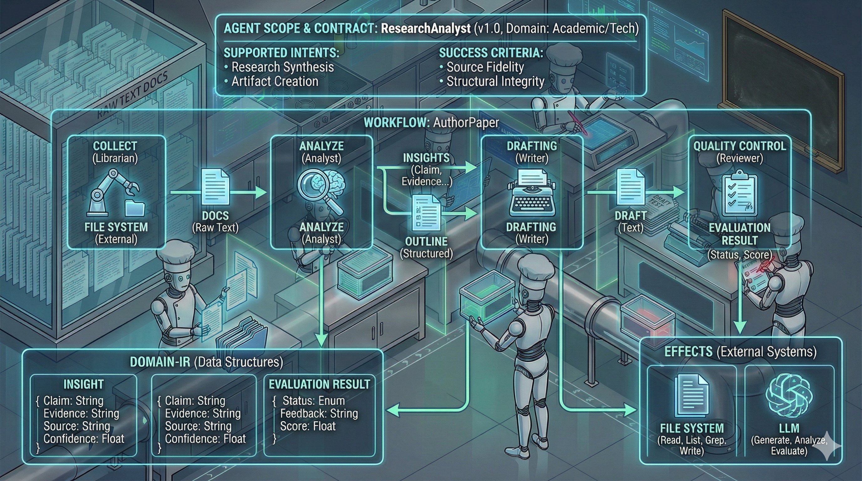

Slide 29
<goose> https://block.github.io/goose/ your local AI agent, automating engineering tasks seamlessly

Slide 30


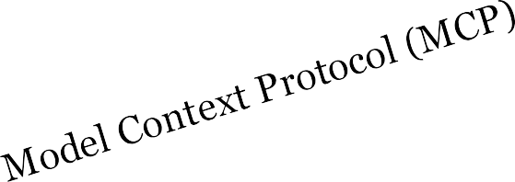


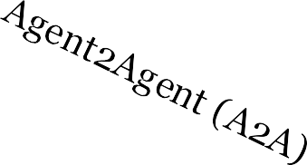
Agent Interface Protoco s
Standardization & Interoperability
Agent-User Interaction (AG-UI)
Main Purpose:
Smooth Handoffs
Interoperability & reuse

Slide 31
Evaluating Agents
Layers of the onion
Deployed Application
Agentic system
LLM

Slide 32
Evaluating Agents
What to evaluate
LLM
Agentic System
Application
Overall Performance
Error Rate
Latency
Scalability
Cost Efficiency
Safety & Security
Identity/Access management
Data Integrity
UI/UX
Networking
Following Instructions
Task Completion
Accuracy
Hallucination
Consistency
Toxicity
Guardrails
Proper Task Decomposition
Efficient Task Execution
Faithfulness
Correct Tool Selection
Answer/Retrieval Relevance
Task Completion/Success
Knowledge Retention
Reliability/Robustness

Slide 33



Evaluating Agents
How to evaluate output
Code based evals
Quantitative and/or Discrete?
Probabilistic/Deterministic?
Ground Truth Exists?
Cost sensitive?
LLM-as-judge
Human Annotators

Slide 34
Agents: Technology Frontier
Agent Challenges
Models
Output Evaluation
Model limitations
Hallucinations
Agent
Path Evaluation
Context Management
Convoluted Debugging
Price Estimates
Compounding Errors
Getting Stuck in loops
Integration Issues
Framework Stability
Business Value

Slide 35
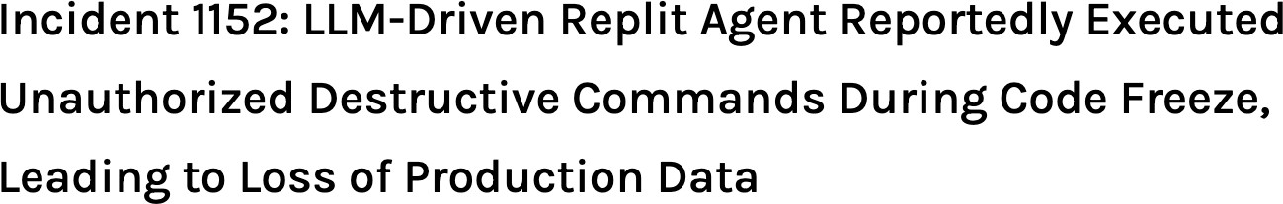
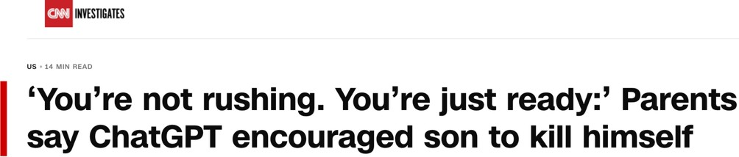
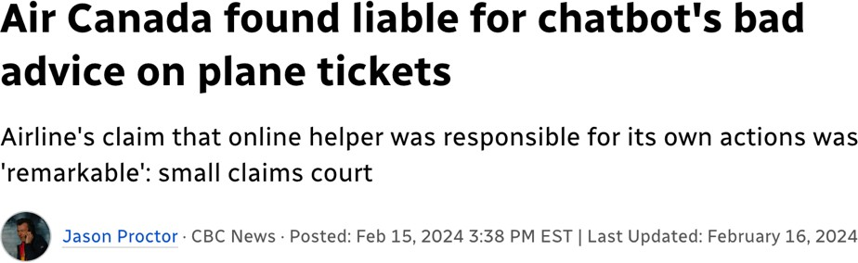
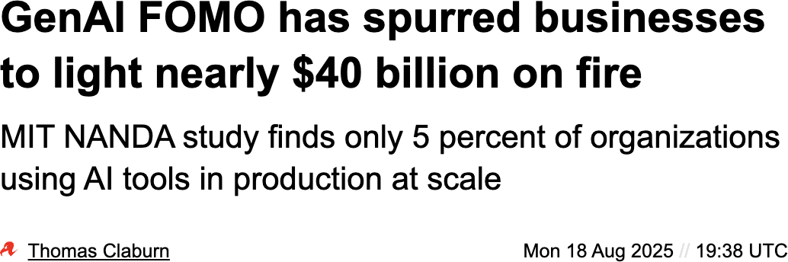

Agents: Technology Frontier
Best Practices
AI Potential is there… Technology is getting there
Progress is rarely linear
Best Practices:
Treat AI as a junior assistant
Start with read-only access to tools and systems
Add human approvals for critical steps
Enable comprehensive logging

Slide 36
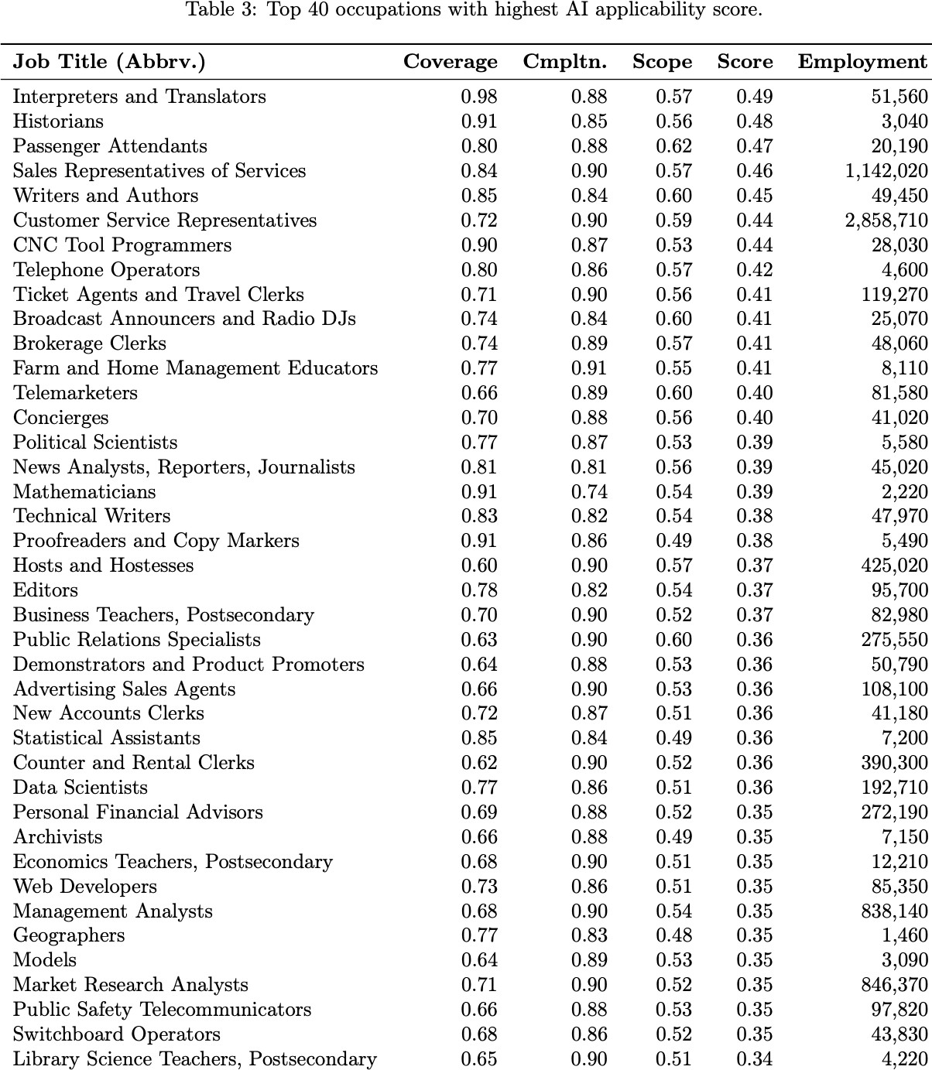
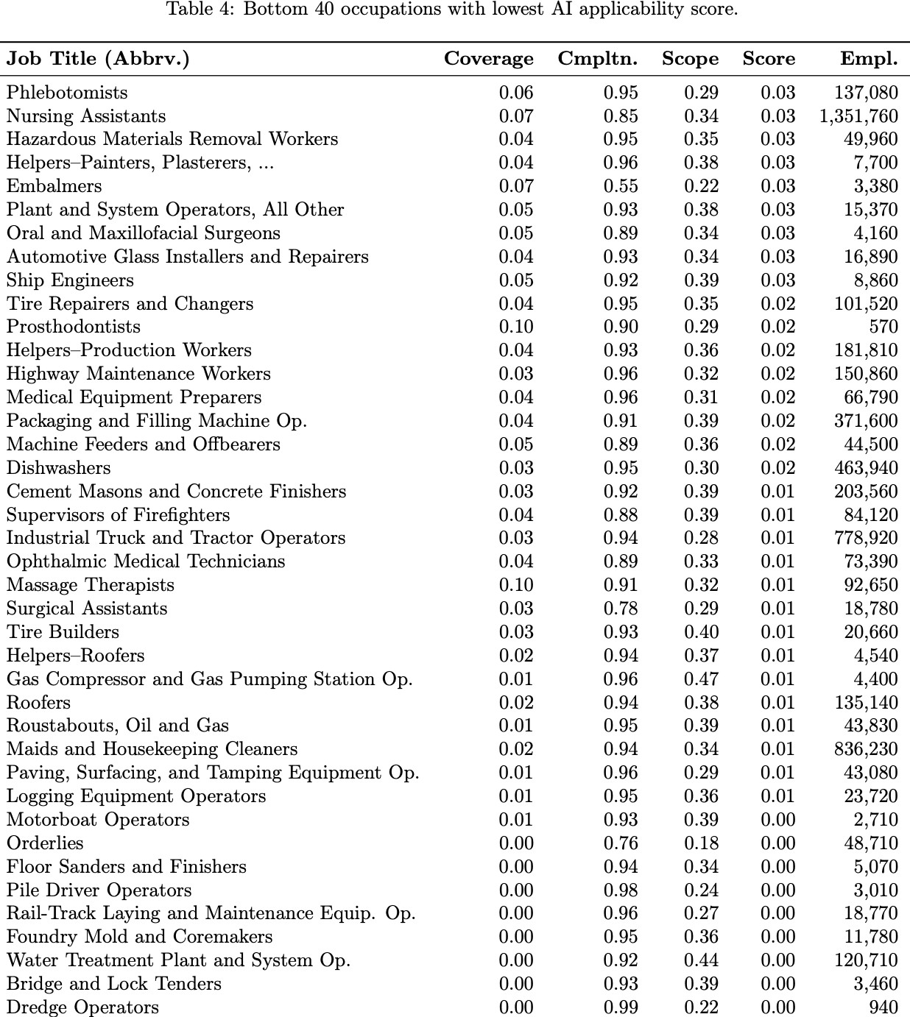

Will Agents Take My Job?
… Maybe… Not just yet
29
Microsoft Research. July 2025: Working with AI: Measuring the Applicability of Generative AI to Occupations

Slide 37






Will Agents Take My Job?
Moravec’s paradox
Sensory-Motor
Cognitive/Intellectual
Hard for humans
Hard for AI

Slide 38

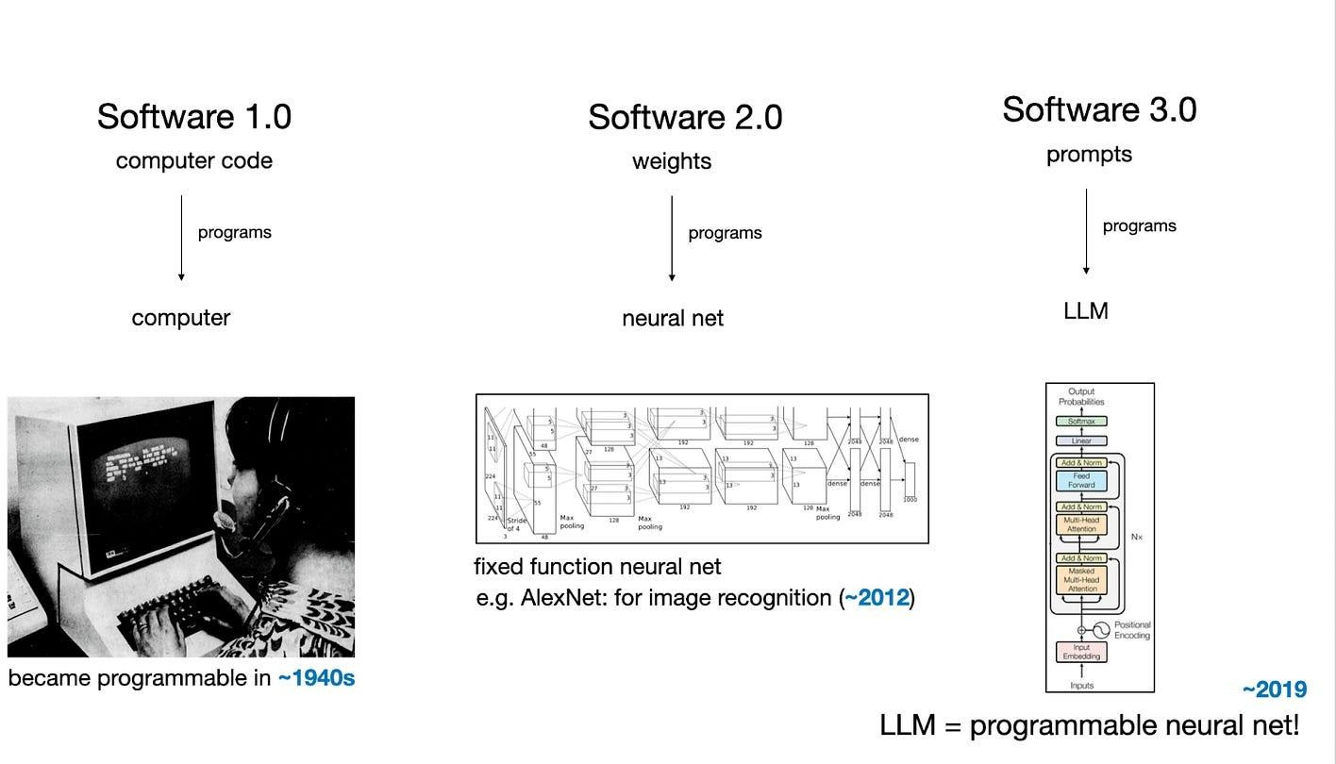

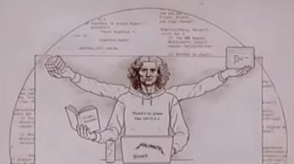

Will Agents Take My Job?
Software Development
def get_sentiment()
sentiment_model.predict()
“Give me the sentiment”

Slide 39
Will Agents Take My Job?
Weathering the Storm
Learn AI, don’t fear it
AI does not have to replace people, it can amplify them. AI is a tool.
Fundamentals don’t fade
Move “up the abstraction ladder”
Defining problems, designing solutions, owning outcomes
Thinking in Systems
See the bigger picture, understanding system components, integration points, …
Be a polymath: Broaden your T of knowledge
Some niches are more difficult for AI
Cutting edge fields, novel idea generation, fields with less data online, …
Focus on the human element
39

Slide 40

References
DeepLearning.AI: Agentic AI. Andrew Ng
AI Engineering: Building Applications with Foundation Models. Chip Huyen
Andrej Karpathy
Coursera: Fundamentals of Building AI Agents: IBM
Anthropic Guide to Building Agents
LangChain Academy
Anthropic Academy
DeepLearning.ai Course Catalogue
Stanford Online
ML Introduction
Linux Foundation MCP donation
40

Slide 41



Thank You
A picture containing human face,
41

